Slide 1
Altar Guild Project
Hope Lutheran Church

Slide 2
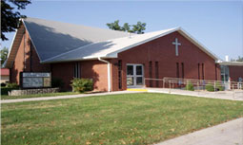
Hope Lutheran Church
931 S. Main Street
Maryville, Missouri
Congregation of 130 members
Supports the Lutheran Campus Center
I am there Tuesday-Friday, 9:00 am – 12:00 noon

Slide 3
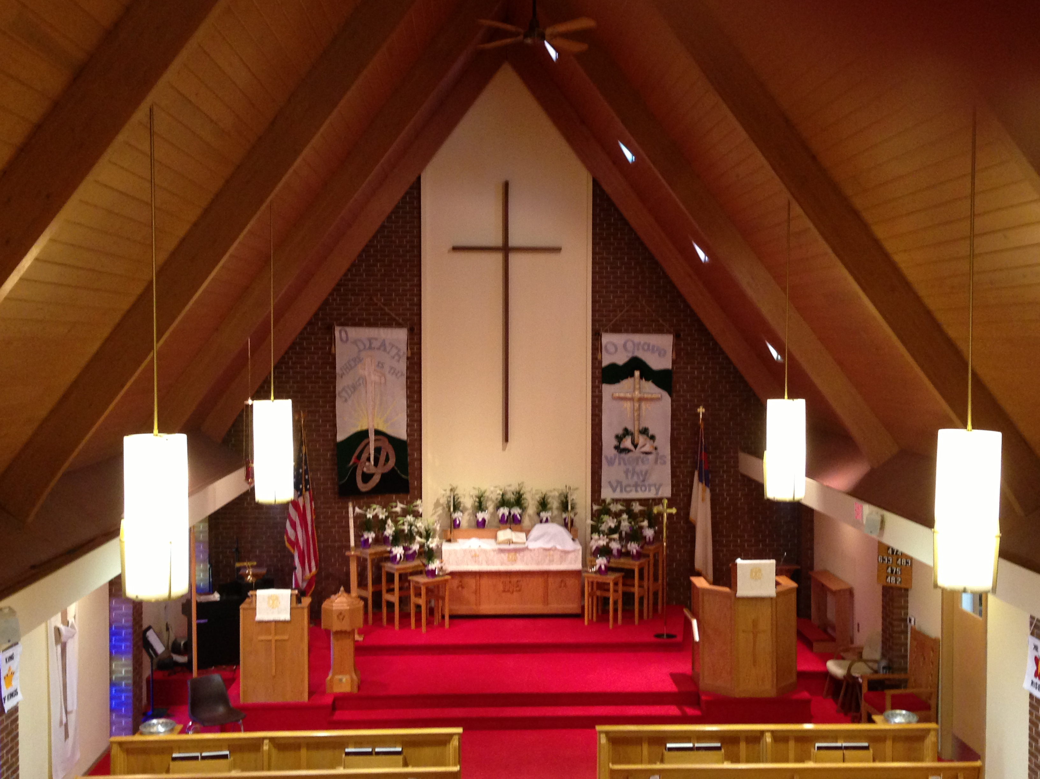
Church Interior
Paraments
Cloths on Altar, Pulpit and Lectern
Different Colors for Different Seasons
Banners – Change with season and holidays
2 front banners
1 side banner
Small Aisle banners

Slide 4
Altar Guild
Committee of 10 Church Members
Two or Three Members are assigned to each month of the year
Duties
Place correctly colored paraments on the altar, pulpit and lectern
Choose banners, prepare them and hang them up

Slide 5
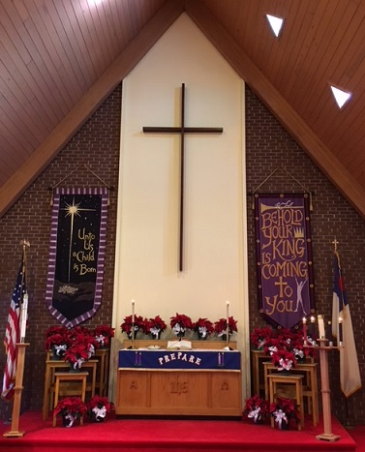
The Church Year
Starts 4 weeks before Christmas
Divided into Seasons
Colors change with Seasons
Scripture Lessons are assigned for each Sunday
--Old Testament
--New Testament
--Gospel Lesson

Slide 6
Special Times in the Church Year
Christmas and Epiphany
Ash Wednesday
Palm Sunday – Easter Sunday (Holy Week)
Palm Sunday
Holy (Maundy) Thursday
Good Friday
Easter Sunday

Slide 7
Special Times in the Church Year
Beginning of Pentecost
Pentecost Sunday
Trinity Sunday
Rally Day – Beginning of the Sunday School Year (usually 2nd Sunday in September)
Reformation Sunday (Last Sunday in October)
All Saints’ Day (1st Sunday in November)

Slide 8
Banner Organization
Currently information on Banners is in a notebook
Not well organized
Banners are color coded and numbered, but not all are associated with seasons
No good coordination of information
Banner notebook stored in the basement with banners, whereas schedule and contact information is located upstairs near sanctuary

Slide 9
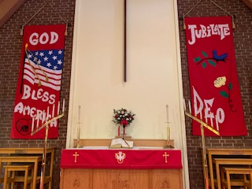
What to know about banners
What season they should be hung?

Slide 10
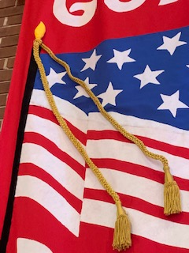
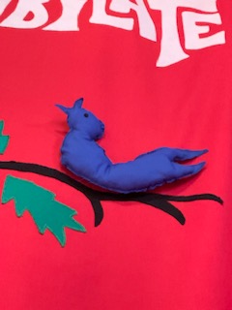
What to know about banners
What season they should be hung?
Any special preparation for the banner?

Slide 11
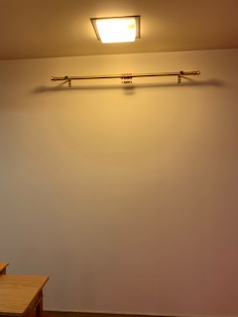
What to know about banners
What season they should be hung?
Any special preparation for the banner?
Is there a side banner to go with them?

Slide 12
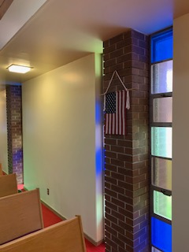
What to know about banners
What season they should be hung?
Any special preparation for the banner?
Is there a side banner to go with them?
Are there aisle banners to go with them?

Slide 13
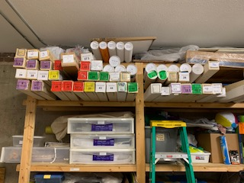
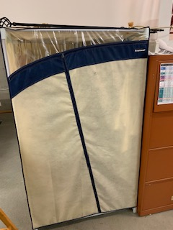
What to know about banners
What season they should be hung?
Any special preparation for the banner?
Is there a side banner to go with them?
Are there aisle banners to go with them?
Where are they stored?

Slide 14
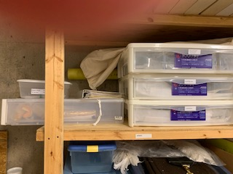

What app needs to do in relation to paraments
Identify the color of the parament for each week of the church year

Slide 15
What the app needs to do in terms of banners
Identify banners associated with each season
Identify whether the banners are front banners, side banners or aisle banners
Identify banner pairs (2 banners that are always hung together in the front)
Identify any special preparations for each banner
Identify where the banner is stored

Slide 16
What the app needs to do in relation to the Altar Guild
Identify Guild members and their contact information
Identify which months the guild members are assigned to work

Slide 17
Dreaming Big
Banner are cross-referenced with weekly scripture readings, so members could put up banners based on what was being read from the Bible that week.
Include historical information with each banner so members know who made it and when and for what occasion.

Slide 18
Questions?

Slide 19
Thank you!!!!
We are thrilled you are helping us with this!

